Slide 1
ADOPT A PLANT
BY AMAN RAJ
REGISTRATION NUMBER - 12106020

Slide 3
What Is Community Development, Its Importance In present scenario?
Community development projects are a means of strengthening a local region in one of many different ways. There are several types of community development projects, including those aimed at helping specific segments of the community, improving safety conditions, and enhancing social and cultural pursuits throughout the region.

Slide 4
BRAJINA FOUNDATION
Motto: Be Good n Do Good!!! Nothing is Impossible!!!
Vision: Sustainable Rural Livelihoods (Rural development, Poverty Reduction and
Environmental Management)
Goal/Mission: Empowering Rural Youth and Women towards a Sustainable Future by Creating Opportunities for Economic Empowerment and generating Employment by training and education with the help and application of modern technologies.
Core Values: Excellence, Integrity, Innovation, Collaboration, Inclusiveness and equal opportunities, sustainability, Respect, Accountability,

Slide 5
Name and brief of the NGO program you worked with.
YOUTH FOR CHANGE
youth for change program Is working for the well being of our planet and empowering
today's youth . In this program we are mentoring youth so that they can work efficiently for brighter future .

Slide 6
INTRODUCTION
“ Adopting a plant means we are taking whole responsibilities of the plants from their birth till death “ with this we can ensure that the plants planted by them become their responsibility and also priority to look after them

Slide 7
Area selected for this project
West champaran(27.1547) is also known for its open border with NEPAL. There are many factories working in this district mainly the sugar factories in (Ramnagar , Narkatiaganj, Bagaha and Lauriya)
We also planted plants near the bank of rivers which enters INDIA from NEPAL because these rivers lead the way to heavy soil erosion and flood in northern BIHAR.

Slide 8
Benefits of plants
Trees combat with climate change
Trees cleans the air
Trees provide us oxygen
Trees helps in preventing soil erosion
Trees provide food
Trees helps with drought mediation

Slide 9
Problem identification
There are two types of problem which are identified .
1. Problem before planting plants
2. Problem after planting plants
BEFORE
PROBLEMS
AFTER

Slide 10
PROBLEMS BEFORE PLANTING PLANTS
CLIMATE CHANGE
CONTAMINATION OF AIR / AIR POLLUTION
SOIL EROSION
GLOBAL WARMING
FLOOD

Slide 11
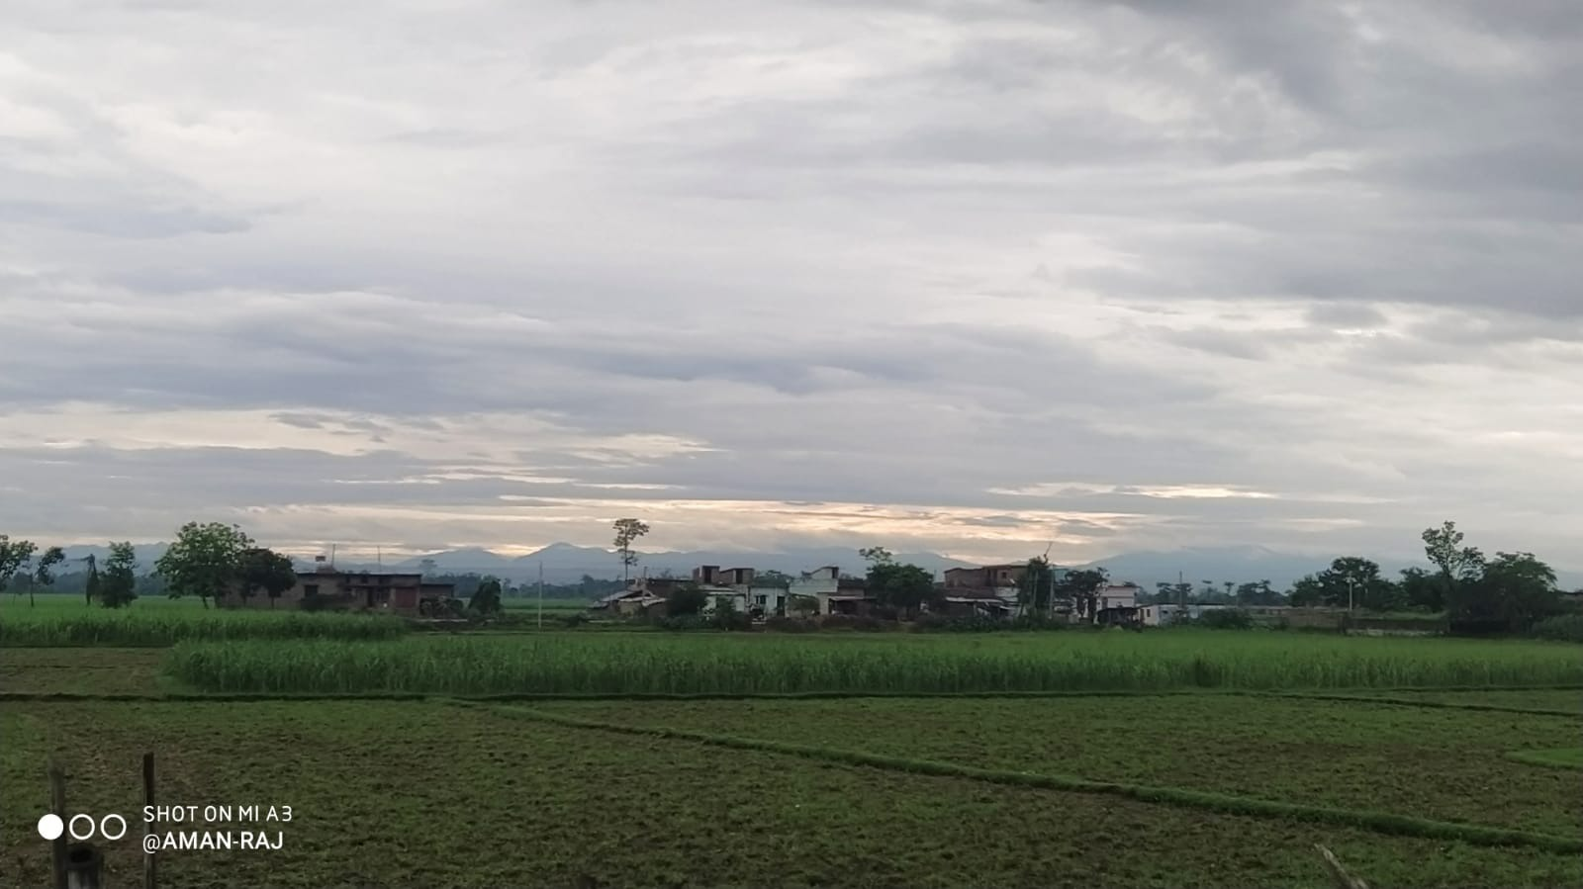
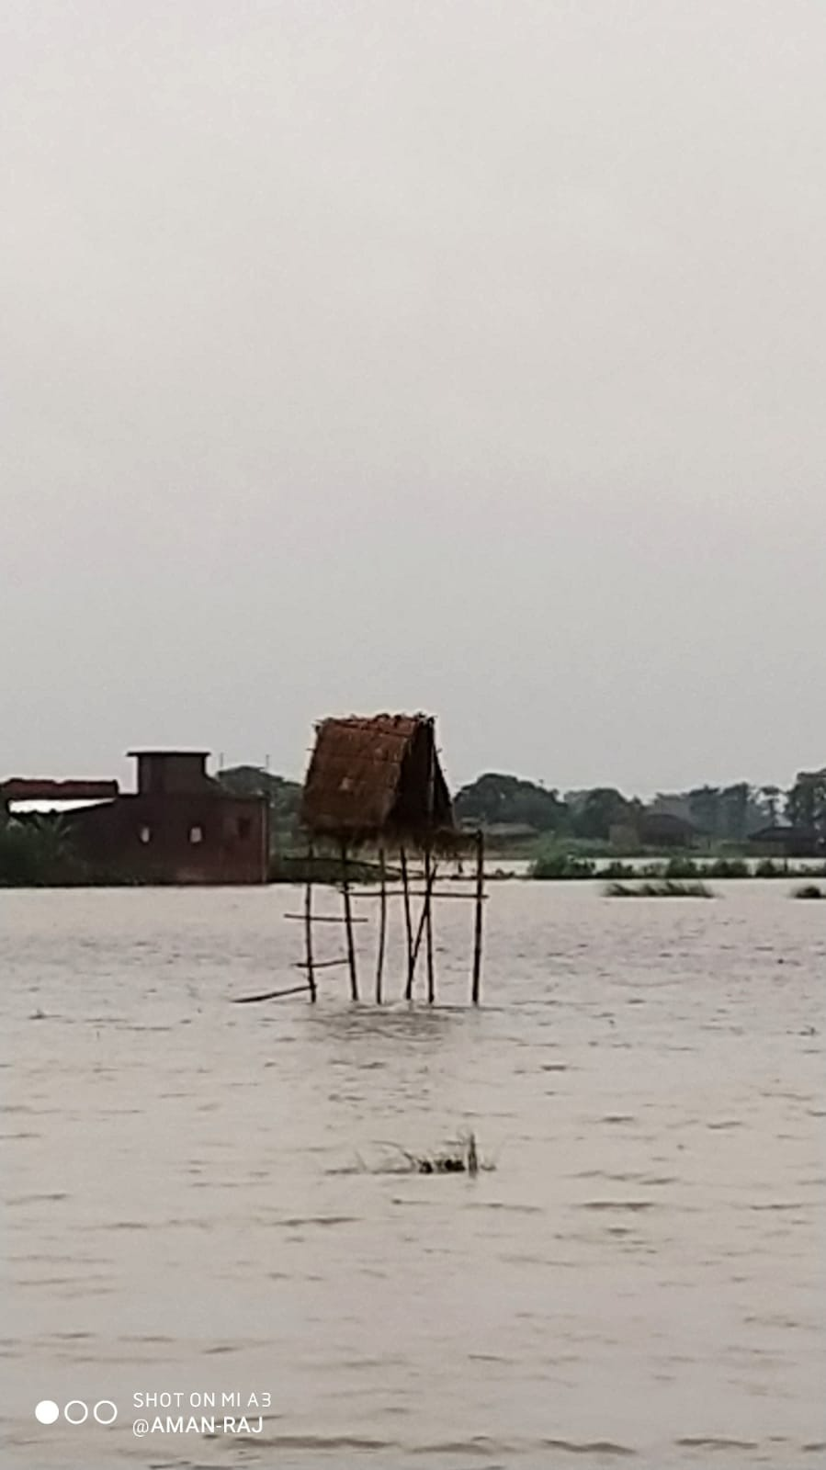
1).BEFORE
2).AFTER

Slide 12
PROBLEMS AFTER PLANTING PLANTS
When you have planted multiple trees then you can except 80% success rate In the plantation . 20% of trees may fail In long run even If the are planted because they are
Not having proper care
Not been watered time to time
Grazed by the street animals
Cut by peoples for field of agriculture or for establishing society/city
Distroyed in heavy rainfall, wind storm, or flood .

Slide 13
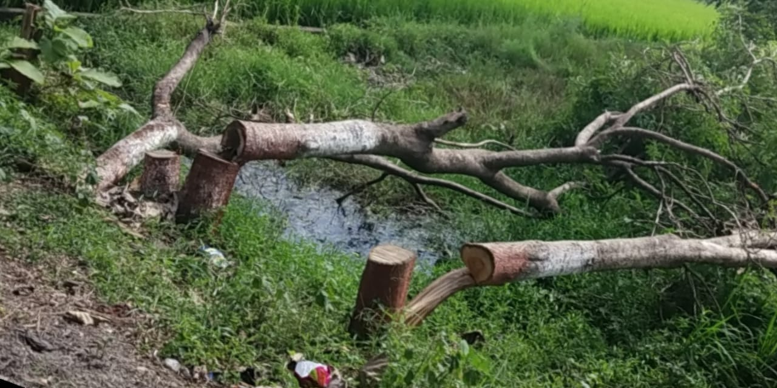
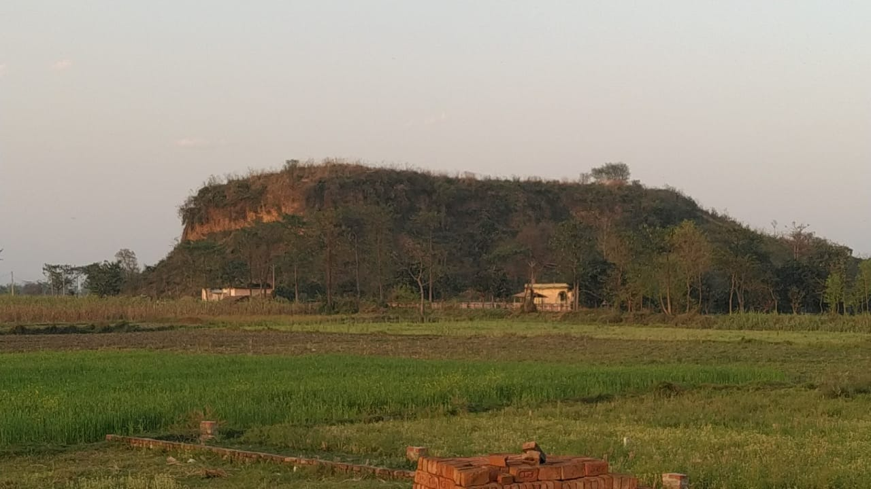

Slide 14
Objectives to be achieved
1. Social :-
I. Build community sprits and unity .
II. Educate community about the benefits of trees and nature
2. Economical :-
1. To make people aware that they can do agribusiness while planting plants agroforestry
2. It will be one of our objectives,to provide the public with access to information, about initiatives and incentives for agriculture, food production and food nutrition, on various scales; from the kitchen gardener to industrial farmer.

Slide 15
Objectives to be achieved
3. Environmental :-
We will plant trees to promote the conservation of our natural resources. planting efforts will ensure our country conserves its biodiversity; and in conserving our biodiversity, we conserve our history; and our legacy.

Slide 16
VARIOUS STEPS TO PROTECT OUR PLANT AND ALSO MOTIVATE PEOPLE TO ADOPT PLANTS
Government and other organisation are doing a great job of planting trees .People are being encouraged to plant trees In there surrounding through various campaigns run by government and also by non-profitable NGOs . But they do not have infrastructure to keep looking after them forever due to which trees may fail In long run so we must take some Initiatives to Adopt a plant and also to look after them after planting them.

Slide 17
VARIOUS STEPS TO PROTECT OUR PLANT AND ALSO MOTIVATE PEOPLE TO ADOPT PLANTS
1) Planting commercial trees
2) Planting medical plants
3) Planting food and shelter providing plants
4) One of our most unique Initiative taken by our foundation is to make people aware about the Importance of plant and promote people to plant trees on the name of there child

Slide 18
VARIOUS STEPS TO PROTECT OUR PLANT AND ALSO MOTIVATE PEOPLE TO ADOPT PLANTS
As this idea is used earlier in a village of Bihar named as Dharhara near Bhagalpur. In the village villagers celebrate the birth of there girl child by planting sapling and they take care of that plant as they are taking care of their children. And now the result is that the village is more greener that other villages.
This initiative was also supported by the Government of Bihar and in respect of that govt. of Bihar launched a welfare scheme “PAHLI KILKARI YOJNA ”

Slide 20
CONCLUSION
It is time people must recognize the importance of tree plantation and contribute towards the same. The government must take this issue seriously and work towards involving more and more people to further the cause and even People must be sensitized about it so that they participate in large numbers. A big change in this direction is only possible if each one of us takes it as a responsibility to plant trees. Even if we do not have time to join an NGO and go with them on the drives regularly, we can make our contribution towards the cause by simply planting trees in our surrounding areas.

Slide 21
REFERENCES
Understanding Bihar Floods 2021 – Simplifying Official Information – Megh Pyne Abhiyan(wordpress.com)
BIHAR STATE DISASTER MANAGEMENT AUTHORITY (bsdma.org)

Slide 22


